Slide 1

MARVEL-ous Data Mining : The Next MARVEL Star

Slide 2


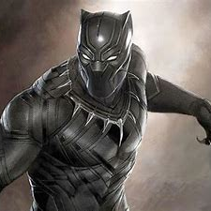

Team Members
Aditi
Ogidan
Paul
Pauline

Slide 3
Goals
Identify the next Marvel star and film to release
Identify 3 top first weekend release locations

Slide 4
Hypothesis Multi-character Marvel franchises are more successful than single character films, regardless of demographic

Slide 5
Questions Asked
What are the top Marvel Movie Franchises?
What characters interact with each other in the Marvel Universe?
What would comprise a successful movie release strategy?

Slide 6




Tools Used
Pandas
Marvel API
Census API
Gmaps
Pyvenn
Wordcloud
MCU API
Simplemaps.com
Mpaa.org
Google

Slide 7
Top Grossing Movies

Slide 8
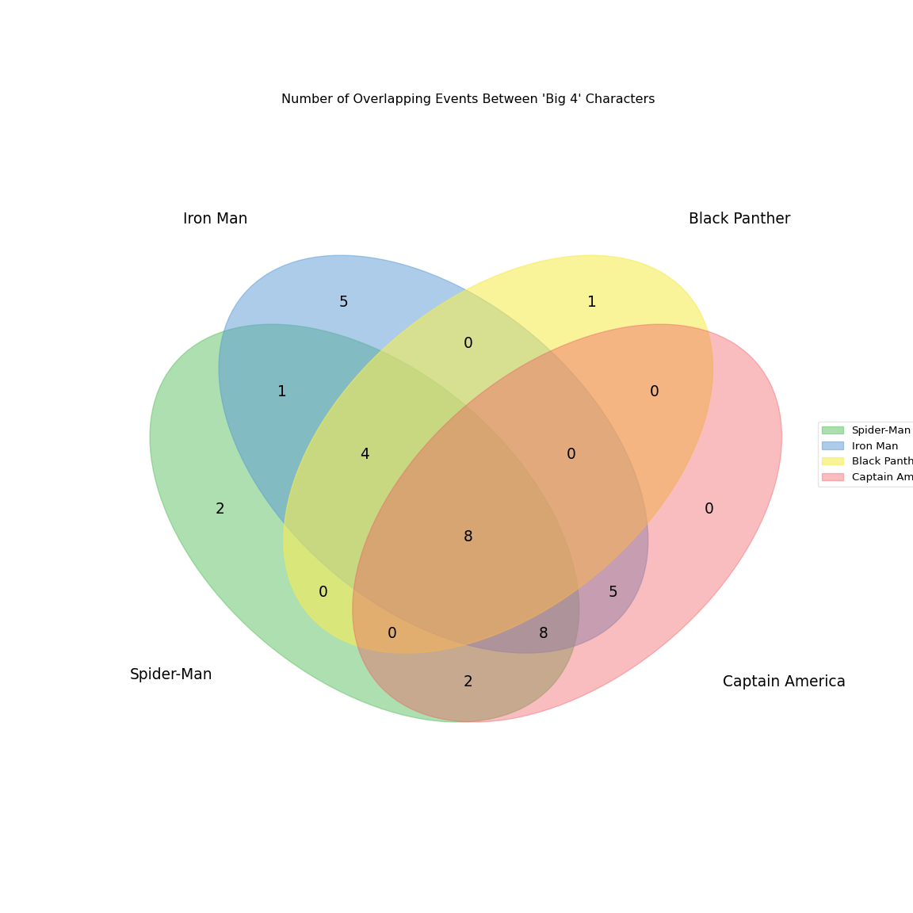
Number of Overlapping Events Between "Big 4" Characters
Number of Overlapping Events Between "Big 4" Characters
Number of Overlapping Events Between "Big 4" Characters
Iron Man
Black Panther
Capt America
Spider Man

Slide 9
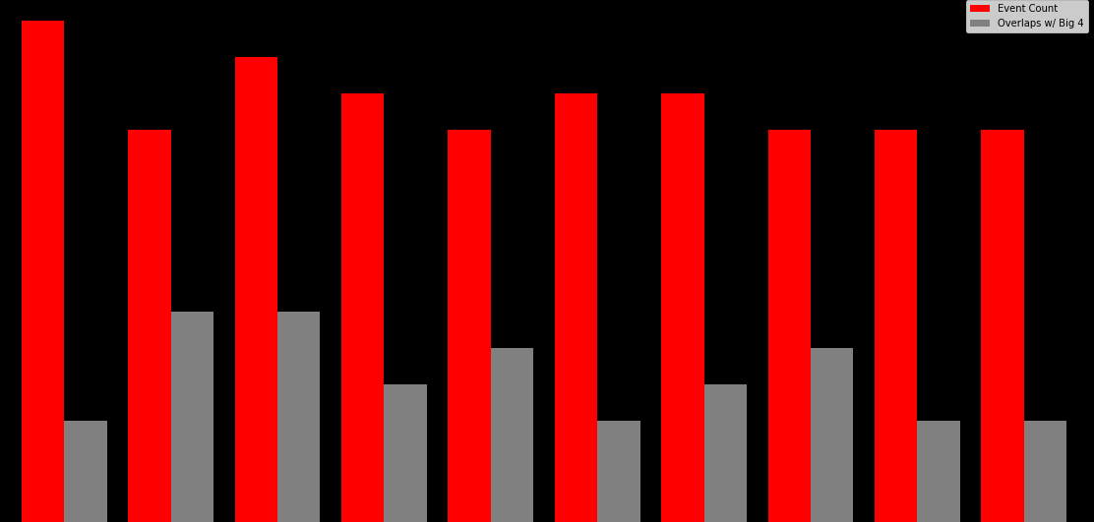
Character Bar

Slide 10


Conclusion
Character : Namor
Event: Fear Itself

Slide 11
Opening Weekend Release
Census data clean up
Zips data clean up
Data Merge
Census data
US zip codes

Slide 12
Data Exploration for Movie Release
Industry research
Descriptive statistics
Data Distribution
Zscore Calculation
Heat Map weight

Slide 13
Graphs

Slide 14
Based on our calculations, the top 3 cities with the highest combined z-scores (closest to one) were: Sioux Falls, SD Page , AZ Gonzales, CA This was a surprising conclusion as we were expecting populous metros (like NY, LA, Chicago) to come up with the highest scores. We attribute this to using an absolute number for age, as opposed to the mean.
Conclusion Release

Slide 15


